Slide 1
Quinten Finance
Presentation offer
October 2025

Slide 2
SMARTER DECISIONS - MEASURABLE RESULTS
Powered by AI
STRICTLY CONFIDENTIAL
Quinten Services Capabilities
October 2025

Slide 3
Agenda
Global Capabilities
SMARTER DECISIONS, MEASURABLE RESULTS
USE CASES

Slide 4
Global Capabilities

Slide 5

Business-Driven AI, Built for Impact
Address strategic business challenges with AI solutions that leverage advanced technologies and industry-specific expertise. Co-created with clients and supported by powerful in-house tools, our solutions expedite deployment and deliver tangible results in areas such as growth, risk management, and customer insights.
STRICTLY CONFIDENTIAL
Notes:
Peut-on le reprendre de façon si similaire?

Slide 6
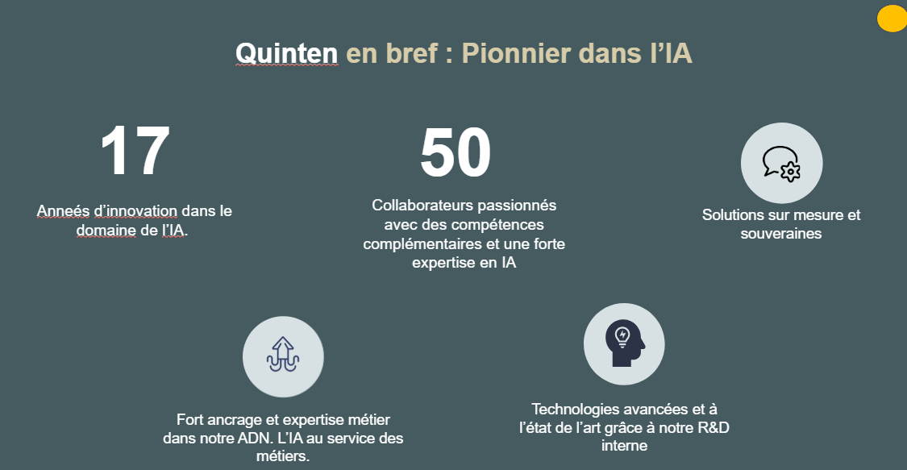

Slide 7



Tailored and Sovereign Solution
Customized, secure, and ready for sovereignty, from concept to delivery.
Artus (L) + Ghita
Quinten at a glance - Data & AI Pioneers
17
50 Passionate experts with complementary skills and deep, hands-on AI experience
Solution personnalisée et souveraine
Sur mesure, sécurisée et prête pour la souveraineté, de la conception au déploiement
Années repoussant les limites de l'IA
Built on Business Insight
Deep business insight and expertise in our DNA. AI serving business.
State-of-the-Art Tech
Advanced methods powered by in-house R&D for solutions that are robust, scalable, and future-proof

Slide 8
The trust of the most demanding stakeholders
Text:
Simon (L) + Thomas
At Quinten Finance, we have completed dozens of projects in the demanding fields of finance and the public sector:
Translate into English
Public sector companies:
Advanced modeling to transform complex data into actionable insights (e.g. absenteeism issues in the public sector).
BPI & Ministries:
Corporate intelligence solution leveraging GenAI technologies to enhance existing tools and support strategic decision-making
Bank Industry:
100+ projects to drive impactful outcomes, combining tool-based consulting on risk, fraud, and marketing challenges.
Text:
Format not great; change order?
Text:
Making + appear: DEMANDING and strategic domain (e.g. absenteeism in the public sector = key; fraud in banking = key, innovation development = key etc...)
Text:
+ industrialization

Slide 9
Text:
SMARTER DECISIONS, MEASURABLE RESULTS

Slide 10
Text:
De l'analyse à la mise en œuvre : ce que nous livrons pour accélérer les décisions
Text:
Glossary with a "grippier" and more biting tone:
Text:
@Simon: actually I find this one relatively OK but I'd like to hear your opinion on it 😊
Text:
→ Investigations driven by insights, transforming complexity into clarity with actionable recommendations in line with regulatory and business constraints.
→ Tailor-made AI tools, created for speed and impact on critical topics. Can be scaled and implemented on-site.
→ AI and data roadmaps, crafted to translate strategic vision into actionable, measurable results.
Text:
Simon (L) + Augustin
Notes:
Qu’est ce que l’on propose comme livrables?

Slide 11


Text:
An integrated, context-adaptive consulting approach combining insights, tools, and transparency.
Text:
Artus (L) + Simon
Text:
Transparent, collaborative consulting built on explainable AI.
We believe collaboration and clarity drive better outcomes.
Text:
Outil-augmented consulting
Text:
Consulting basé sur les insights
pour des décisions cruciales. Nous combinons:
Text:
conçu pour accélérer les projets à fort impact.
Notre boîte à outils comprend:
Text:
Rapid immersion in the client context
Iterative problem framing with stakeholder input
Continuous insight validation and adaptation
Deep collaboration with domain experts to produce clear, actionable conclusions.
Text:
Données communes spécifiques au domaine pour des ensembles de données cohérents et réutilisables.
Algorithmes propriétaires pour la détection de sous-groupes, le scoring et les insights prédictifs.
Recherche et développement continue de GenAI pour améliorer les capacités d'analyse et débloquer de nouvelles opportunités.
Notes:
Quelles sont nos méthodes de travail? Ou : Deep-Dive Consulting

Slide 12

Text:
Consulting in transparent, explainable AI that delivers measurable results.
Text:
Artus (L) + Simon
Text:
Nous associons des connaissances sectorielles à des outils prêts à l'emploi pour réduire le délai de création de valeur et réduire les risques liés aux décisions.
Text:
Consulting basé sur les insights pour des décisions cruciales. Nous combinons :
Text:
Outil-augmented consulting
conçu pour accélérer les projets à fort impact.
Notre boîte à outils comprend :
Text:
Une immersion rapide dans votre contexte et vos contraintes.
Un cadrage itératif des problèmes avec la contribution des parties prenantes.
Validation continue des idées et adaptation.
Collaboration étroite avec des experts du domaine pour produire des conclusions claires et actionnables.
Text:
Données communes spécifiques au domaine, prêtes pour la production.
Algorithmes propriétaires pour la détection, le scoring et la prédiction de sous-groupes.
Recherche et développement continue de GenAI pour débloquer de nouveaux cas d'utilisation.
Notes:
Quelles sont nos méthodes de travail? Ou : Deep-Dive Consulting

Slide 13
Text:
Nous soutenons nos clients dans la transformation de leur façon de prendre des décisions, à travers quatre niveaux d'intervention complémentaires - en fonction de leurs besoins : Recommander, Comprendre, Prédire ou Assister à la prise de décision
Thomas (L) + Augustin
Review wording details
Text:
Recommend –
Shape & define data opportunities
Text:
Comprendre —
Diagnostiquer et donner un sens à la complexité
Text:
Prévoir —
Anticiper et déclencher les bonnes actions
Assister -
Accélérer la prise de décision en temps réel
Identify AI use cases, define strategic roadmaps, and de-risk data initiatives.
Uncover and structure complex business phenomena using heterogeneous data to clarify root causes and measure impacts
Identify weak signals, generate forecasts, and uncover emerging risks or opportunities. Enable targeted, timely action before issues escalate.
Provide augmented intelligence connected to real-time and external data to support and enhance human reasoning.
Add KPIs
Add external data
Identification of use cases for retail banks
Data roadmap for insurance
• Diagnostic de l'absentéisme des RH
• Diagnostics des performances de vente
• Audit de l'efficacité marketing
• Étude de la rétention des clients
On-premise daily churn alerts
Workload forecasting over several period of time
Live Fraud Detection
Commercial recommendations
GenAI powered prospecting tool
Real-time business insights
Business-specific intelligent assistant
Taking a higher perspective: disaffection; energy needed to change state, disengagement...
Exemples
• AI roadmap
• Strategic recommendations
• Diagnostic basé sur les données
• Plan de remédiation
• Risk and opportunity scores
• Alerting systems
• Action prioritization
• Custom AI assistant
• Augmented search engine
• Real-time recommendations
Deliverables
Notes:
Quel service on rend?

Slide 14
Strategic business challenges addressed with AI-powered solutions helping organizations make faster & smarter decisions
Impact of subsidiary name?
Include the benefit in the name (QuintenAffordable)
Text:
CustomerAI a bit limiting and too close to People: GrowthAI? (internal)
Text:
Augustin (L) + Thomas + Artus
TargetAI
PeopleAI
CustomerAI
RiskAI
Inorganic growth & market development
Example: Identify high-fit M&A or partnership opportunities
Workforce performance
Example: Uncover root causes of absenteeism and HR disengagement
Sales & marketing performance
Example: Predict churn, optimize offers, forecast demand
Risk & compliance
Example: Detect fraud, alert on business failure
Text:
Display the relevant departments
Notes:
A quelle problématique métier on s’attaque? TL : lister les directions ciblées

Slide 15
Text:
Strategic business challenges addressed with AI-powered solutions helping organizations make faster & smarter decisions
Augustine (L) + Thomas + Arthur
Quinten Insight
Text:
Q-Hunter / Target AI
Q-Worker / Perform AI
Q-Booster / Predict AI
Q-Protector / Shield AI
Text:
External growth & market development
Prospection, Identify high-fit M&A or partnership opportunities
Text:
Workforce performance
Uncover & explain root causes of observed phenomena (ex: disengagement)
Text:
Process & Internal performance
Predict clients’ behavior, optimize targeting, forecast demand
Text:
Risk & compliance
Detect outliers and fraud, alert on business failure
Corp Development, Strategy, Commercial, Business Dev, Purchasing Dept, Marketing, Financials, M&A
HR, Operationnals, Strategy, Financials
Marketing, Sales, CRM, CFO, Operationnals,
Risk, Fraud, Sales, CFO, Operationals
Teams
Cas d'utilisation
Notes:
A quelle problématique métier on s’attaque? TL : lister les directions ciblées

Slide 16




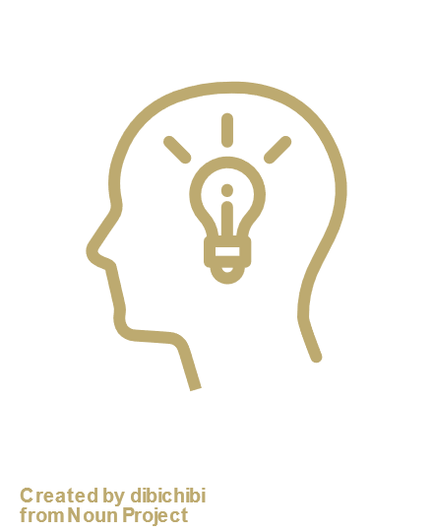

Nos compétences
Ghita (L) + Artus
Get inspired by the QH slide: more details, more differentiation!
GenAI
(LLM, RAG, NLP, OCR)
Science des données
(Apprentissage supervisé/non supervisé en ML)
"We are 5 ahead technically" "from POC to industrialization" etc... RAG / GenAI / Agentic ..
Industrialization
MLOps, DevOps, UI/UX
Insight Specialist
Project Manager, Sector Experts
Visualization
PowerBI, Tableau
Notes:
Nos équipes / expertises

Slide 17
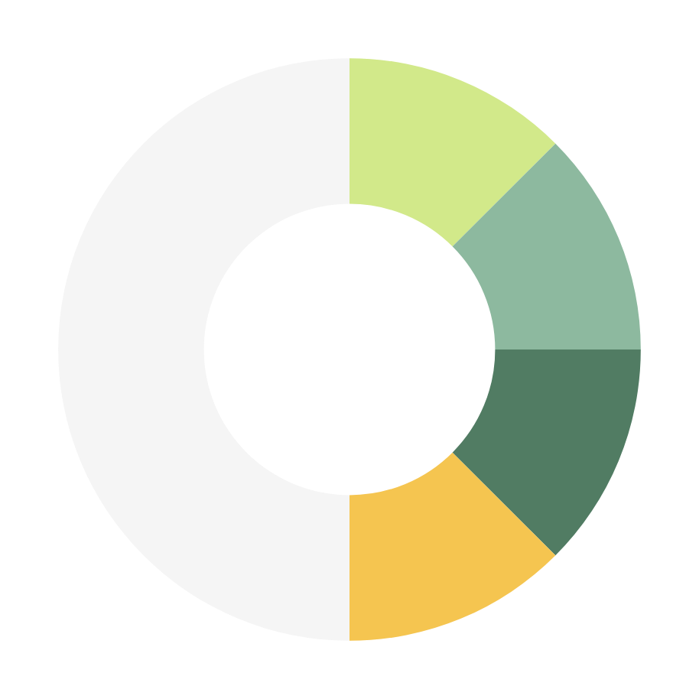


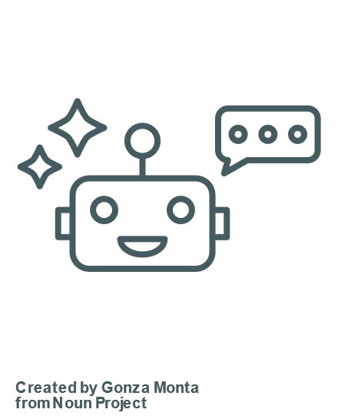

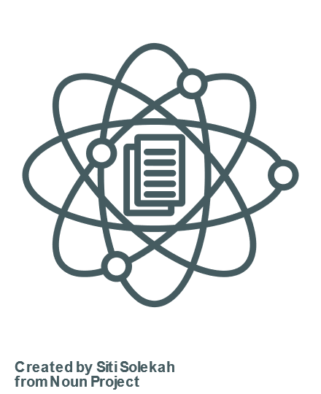


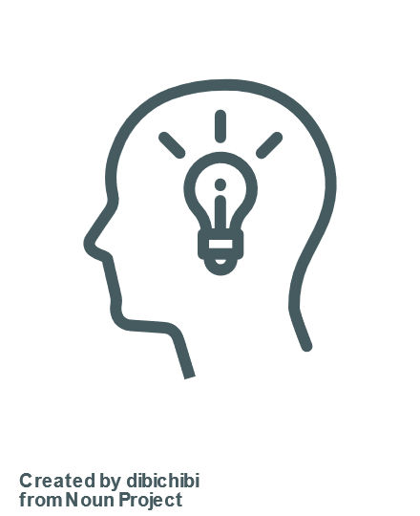
2
GenAI
At Quinten Finance, nous construisons le pont entre l'innovation et l'exécution. Nos équipes combinent une expertise avancée en intelligence artificielle avec de solides capacités de livraison pour passer de la preuve de concept à des solutions évolutives. Avec une culture d'excellence technique et d'agilité, et
LLM, RAG, NLP, OCR, Agentic tools
Data Science
Supervised/Unsupervised ML
Nos compétences
un avantage technologique de cinq ans, nous
Insight Specialist
Project Manager, Sector Expert
constantly provide AI systems that are durable, efficient, and impactful.
Industrialization
MLOps, DevOps, UI/UX

Slide 18


A Team of Highly Skilled AI/GenAI Pioneers and Healthcare Data Scientists
Chefs de projet et consultants
Consultants en biomédecine
Analystes de données
Biostatisticiens
Data Scientists GenAI experts
ML Engineers
ML Ops
Quinten Health a régulièrement formé des pionniers en science des données qui dirigent désormais les stratégies de données et d'IA au cœur des géants de l'industrie pharmaceutique, des perturbateurs de la santé et des cabinets de conseil mondiaux, façonnant activement l'avenir des preuves du monde réel, des plateformes de données médicales et de l'innovation pilotée par l'IA.
STRICTLY CONFIDENTIAL
Ingénieurs en données
Développeurs
Key Opinion Leaders
50+ personnes passionnées par les soins de santé avec un ensemble de compétences complémentaires et une expertise en RWD

Slide 19
Quinten in synergy with the French ecosystem
Simon + Artus (L)
Sovereignty: OVH, Mistral, BPI,
Recruitment from top French engineering schools + partnership with Essec, X/HEC (too old?), JDZ and the supercomputer
Partnership: Topics? Studia?

Slide 20




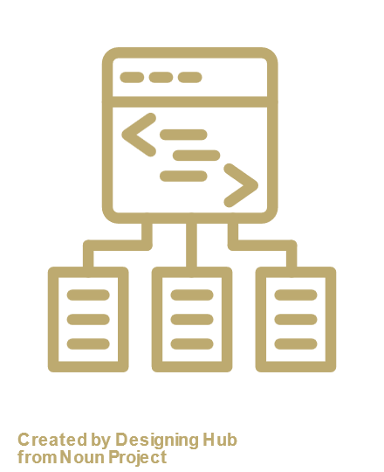




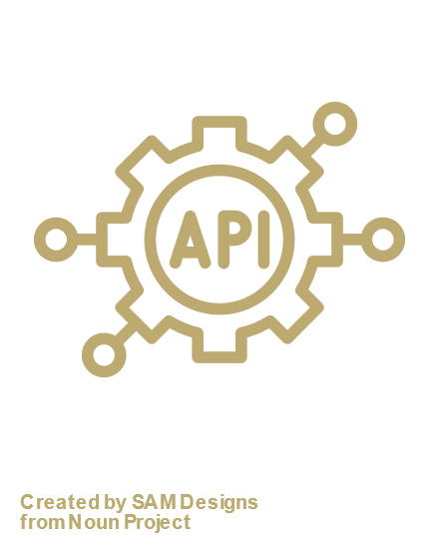
Augustin (L) + Simon
Our data expertise
Based on 17 years of experience and more than 100 projects, we have the ability to work ...
... with complex, high-volume data in constrained and regulated environments
... with external data
... on diverse environments, with widespread platforms and tools
Projects running on-premise for retail banks
Expertise in INSEE and INPI data
AWS, OVH, GCP
Monthly run over more than 500GB of data
Dataiku, Databricks
Process to collect and extract information from news
Prospection tool using sovereign models and infrastructure
Python, R, Spark, BigQuery
Identify, scrape, and structure information from websites
Mistral, OpenAI, Anthropic, Gemini

Slide 21
Nos réalisations
Marketing ciblé - Produits bancaires
2.4 fois plus de ventes que les cibles de contrôle (A/B testing)
Taux de traitement 30% plus élevé par les conseillers bancaires
75% des ventes réalisées auprès de nouveaux détenteurs (contre 45% pour les cibles de contrôle)
Check Fraud
Over 95% of check fraud detected
30% reduction in investigation time
0 service interruptions in 3 years of production
Absenteeism study – Public transport
8% reduction in absenteeism over 12 months, including 25% in certain job categories
Over 100 remediation levers identified across 8 departments
Workload forecast
Number of FTEs reduced by 10% on average, with no decrease in perceived quality
Time required to plan the annual budget reduced by 4×
Number of iterations and simulations far higher than the previous process
Prospection support - Public sector
Over 98% accuracy in linking companies to their websites
50% reduction in time required for prospecting
Twice as many companies identified on average as relevant

Slide 22
USE CASES

Slide 23
List of use cases of interest
Use case | Description | Service | Challenge
SATT |  | Assist | Target
Altares |  | Assist | Risk
IMA |  | Predict | Customer
Fraude |  | Predict | Risk
BRED |  | Understand | Customer
CERA |  | Predict | Customer
RATP |  | Understand | People
Kélio |  | Assist | People
Augustin to finish
Augustin
Thomas + Arthur
Simon
Internal Fraud Thomas?
Ghita
Augustine (x2?)
Thomas + Arthur
Ghita

Slide 24
Identify companies' websites with a high degree of certainty
Template Use Case 1
Objectives & challenges
Méthode
Key results & Impact
Identify with a high degree of certainty the website of a company, based on its name and public information
Detailed and transparent decisions
Efficient on an international scale
High degree of certainty, with specific labels for multiple candidates or uncertain cases
Highly configurable codebase
Use state-of-the-art LLMs and fast scraping technologies to collect the key information
1- Look for the company via SERP (Search Engine Result Pages), located in the company's country
2- Scrape the main page and use Regex to minimize the content to structure
3- Use an LLM and regex methods to structure the content and extract the key information
4- Use all the information available to make the best decision, using strict rules for validation
Improves the reliability of company-URL matching to over 98% when established
More than 700,000 company-URL links generated
Ability to generate 30,000 new links per day at a cost of less than €0.01 per link
Include GRAPHS or IMAGES

Slide 25
Gather intelligent and structured information from any company's website.
Template Use Case 1
Objectives & challenges
Méthode
Key results & Impact
Build an API that can respond to any question from a website if the information is available.
Minimize the cost and the number of explored pages
Automatically adapt to different structures
Scale to thousands of websites explored each day
Store the results in a structured database
Use state-of-the-art Agentic LLMs and fast scraping technologies
1- Use agentic functionalities to allow the LLM to choose the subpages to explore
2- Use Regex to minimize the content to structure and extract information
3- Use external LLM to structure the information
4- Store the information for later exploitation
700,000+ company websites structured and ready for analysis or integration
Ability to answer any questions if the answer is available on the website
Creation of a unique, unmatched company knowledge base
Include GRAPHS or IMAGES

Slide 26
Sovereign solution to facilitate prospecting in the French public innovation ecosystem
Template Use Case 1
Objectives & challenges
Méthode
Key results & Impact
Build and deploy a tool for Business Developers to identify and qualify French companies most likely to incubate a technology
Use collected knowledge of French companies’ activities
Understand and leverage the concepts included in a technology description
Accelerate the Business Developers’ workflow
Utilisez des LLM de pointe et du stockage pour maximiser la compréhension de la requête de l'utilisateur
1- Analyser la requête de l'utilisateur
2- Utiliser SOLR pour récupérer efficacement les candidats les plus pertinents
3- Réorganiser les candidats en utilisant toutes les informations disponibles, y compris les KPI financiers et d'innovation
Reduced prospecting time by a factor of 2
Identified an additional 50% of prospects
TBC..
Include GRAPHS or IMAGES

Slide 27



Our positioning at Quinten Finance:
A sovereign and innovative AI shaped by and for the business
To be translated and proofread
Leader in AI
Business expertise and advice
Customized solutions
Sovereignty
Dozens of AI solutions and GenAI in production used by our clients
Internal Datalab and ongoing technological watch
Several differentiating assets (analysis of weak signals, specific company database, matching engine, etc.)
Expertise in business and banking data
Intervention throughout the chain: from framing to use by teams
Process redesign, skills development, team ownership
Tools co-developed with our clients and business units in production and used
Derivation of Quinten modules into custom features
User interface tailored to your workflow
Data and processing control (France)
Independence from online models
GDPR compliance & avoiding the Cloud Act
Notes:
RECAP

Slide 29

Signaux en temps réel pour la détection des risques de défaillance des entreprises
Challenge
Poor assessment of company health and compromised high-stakes decisions due to outdated data.
Existing tool unused due to excessive false positives and lack of trust
Abrupt score changes led to confusion and high customer support volume.
Data & Method
Ingested real-time signals from hot data sources (e.g., press articles).
Developed advanced NER and entity matching to link companies to the correct SIREN
Built machine learning models to assess risk level
Delivered a SaaS platform with daily alerts for high-risk companies.
Results
Achieved >85% entity matching accuracy.
12x reduction in false positives vs. previous risk model.
Risk scores now evolve gradually, enabling earlier, smoother client communication.
Business Impact
Provided clients with timely, reliable, and actionable risk insights.
Drastically reduced support calls linked to misunderstood score changes.
Strengthened Altares’ market position as a leader in real-time data intelligence.
Protected brand trust by preventing reputational damage from outdated alerts.
STRICTLY CONFIDENTIAL
All use cases are part of Quinten's expertise & track record

Slide 30
Use Case: Augmenter le transfert de technologie grâce à un outil de correspondance alimenté par l'IA
Challenge
Matching a public research technology with the right company was time-consuming and manual.
Incomplete prospecting processus leading to missed opportunities due to national activity databases poorly structured,.
Assessing a company’s appetite for innovation was subjective and lacked standardized indicators.
Many high-potential tech transfers never reached the right industrial players.
Data & Method
Developed a semantic matching engine using LLMs and embeddings.
Matched technologies with companies based on detailed web content — not outdated classification codes.
Built innovation-readiness scoring based on structured and unstructured data (R&D departments, patents, publications, innovation grants, etc.)
Delivered a user-friendly platform ranking companies by both relevance and innovation potential.
Results and business impact
Empowered business developers with a high-precision, time-saving tool.
Enabled faster, smarter, and more exhaustive prospecting.
Standardized innovation scoring enhanced decision-making across SATT teams.
Identified highly relevant companies that were previously missed by existing tools.
STRICTLY CONFIDENTIAL
All use cases are part of Quinten's expertise & track record

Slide 31
QH's Expertise in RWE & AI: Generate RW-based Solutions by Engaging with Stakeholders
Défis thérapeutiques de Quinten
Text:
Track Record
Maladies Rares et Immuno-inflammation: Fournir une génération avancée de preuves pour soutenir la recherche et le développement, l'accès au marché et la gestion du cycle de vie.
Oncologie, avec des Mutations Rares: Anticiper et sécuriser des comparaisons indirectes de qualité réglementaire.
Conditions Cardiovasculaires et Métaboliques, y compris l'obésité.
Parcours de Patients Complexes: Cartographier les parcours de soins complexes pour optimiser les résultats pour les patients et les prestataires.
Text:
500+ projects for 100+ organizations across the healthcare system.
Knowledge extraction from 100+ real-world databases & 100+ RCTs.
Text:
STRICTLY CONFIDENTIAL
Develop Disruptive Real-World-Based AI-Driven Solutions
QH: Quinten Health, RWE: Real-World Evidence, AI: Artificial Intelligence, RCT: Randomised Controlled Trial

Slide 32
Text:
Faites confiance aux parties prenantes les plus exigeantes
We are proud to collaborate with leading healthcare stakeholders, institutions, and regulatory authorities.
AI-Native player with 15+-year existence, tackling some of the most pressing therapeutic challenges for:
Healthcare Industry – Delivering over 500 projects across 100+ organizations to drive impactful outcomes.
Cosmetic & fragrance Industry – Collaborating by turning complex data into actionable insights.
European Medicines Agency (EMA) – Contributing to regulatory-grade projects that meet the highest scientific and compliance standards.
Critical Path Institute – Partnering on cutting-edge initiatives to advance scientific and regulatory innovation through trusted nonprofit collaboration (e.g., disease modeling,…).
Swissmedic – Collaborating with Switzerland’s Agency for Therapeutic Products to develop disruptive GenAI-powered agents.
Banque Publique d’Investissement (BPI) and Ministries – Supported by France’s public investment bank in initiatives related to corporate intelligence and strategic matchmaking, supported health ministries in EU to upgrade their quantitative decision support tools (e.g. for COVID).
STRICTLY CONFIDENTIAL

Slide 33


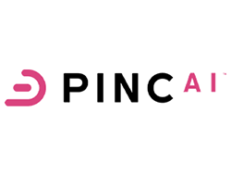











Quinten’s Innovation Ecosystem is Redefining RWE
By combining extensive domain expertise, state-of-the-art technology, and a history of regulatory compliance, Quinten Health is uniquely positioned to expedite the generation of next-generation evidence while staying rooted in regulatory science.
Strategic alliances with Premier Real-World Data Providers unlock economically sustainable data-utilization models and power impactful translational research and medicine.
Collaborating closely with Regulatory Authorities to guarantee that every RWE advancement adheres to the highest standards of scientific and regulatory rigor.
Innovative
RWD Partnerships
Collaborating with Forward-Thinking Partners to amplify impact and build awareness of novel real-world evidence and RCT-enhancement approaches.
STRICTLY CONFIDENTIAL
Réglementation
Science
&
MIDD
Jumeaux numériques
et médecine prédictive
¹
Digital Biomarkers
& Worldwide compliance
Ad Scientiam and MyDataTrust - our Sister Companies - drive breakthrough remote patient-monitoring analytics and guarantee regulatory-compliant scale-up worldwide.
RWE: Real World Evidence
1: IRD - UMMISCO

Slide 34
A Team of Highly Skilled AI/GenAI Pioneers and Healthcare Data Scientists
Project Managers & Consultants
Biomedical consultants
Data Analysts
Biostatisticians
Data Scientists GenAI experts
ML Engineers
ML Ops
Quinten Health has consistently nurtured data science pioneers who are now leading data and AI strategies at the heart of pharmaceutical giants, healthcare disruptors, and global consultancies — actively shaping the future of real-world evidence, medical data platforms, and AI-driven innovation.
STRICTEMENT CONFIDENTIEL
Data engineers
Developers
Key Opinion Leaders
50+ personnes passionnées par les soins de santé avec un ensemble de compétences complémentaires et une expertise en RWD

Slide 35

QH’s Technical Assets: 4 Domains
Our technical assets are structured across 4 main domains. Each domain contains our differentiating and proprietary technical assets developed in-house, in addition to the usual techniques mastered by our teams.
DISEASE & CARE MODELING
Predictive ML modeling with or without interpretability layer
Qfinder: to generate and select subpopulations with significant signal
Qluster: generic workflow for robust clustering
Advanced sequence analysis
Causal inference
Biomedical knowledge graphs
Bayesian networks
SIMULATION & SYNTHETIC DATA GENERATION
Survival analysis, Bayesian statistics, probabilistic models, deep generative AI
SDG with GANs/VAEs/Bayesian networks/Copulas
Synthetic Survival Data Generator
LLM-Based Synthetic Patient Data Engine
Synthetic Data Evaluation Framework​
STRICTEMENT CONFIDENTIEL
NLP & LLM POWERED TASK AUTOMATION
Classic NLP frameworks, Transformers, LLMs, Retrieval Augmented Generation (RAG)
ALIBERT – a suite of models for French biomedical language
Oncodyssee: A pipeline to process and structure oncological patient reports
Q-SLR: AI-based systematic literature process in the medical field
HEALTHCARE & REAL WORLD DATA INTEGRATION
Data engineering, Data audit, Data visualization
OMOP transformer
STabDesc: automated system for descriptive statistics
Sequence visualization: lbox to visualize sequence according to the focus of interest

Slide 36

Quinten Health Innovation Engine
INNOVATION ACCELERATORS
Business-Driven R&D:
As technology is constantly evolving, QH aims to keep innovation at the heart of its activities. R&D work is business-oriented and dedicated to the development of our 4 main domains
20% of our operational time is dedicated to R&D
Academic & Research Partnerships: Close collaborations with methodologists in leading institutes (See slide: Quinten’s Innovation Ecosystem is redefining RWE)
INNOVATION CULTURE
Scientific Monitoring & Knowledge Sharing: Weekly “insight sessions” to review key publications and discuss actionable takeaways.
Skills Development: Ongoing internal and external trainings keep our teams at the cutting edge.
Talent Sourcing & Onboarding: Robust network spanning private sector and academic labs, coupled with an immersive onboarding program that fosters autonomy, teamwork and excellence.
STRICTLY CONFIDENTIAL
INNOVATION OUTPUTS
R&D-Embedded Deliverables: the vast majority of our client engagements include an R&D component, ensuring continuous capability enhancement.
Scientific dissemination: Regular publications and conference presentations showcase our advances in disease modeling, real-world evidence and AI applications.
(See slide: Sample of recent publications on Disease & Care Modeling & Simulation)
QH: Quinten Health

Slide 37

Quinten's commitments towards Health Data & Security
Quinten Health implements a rigorous information security management policy, based on a structured governance system, certified best practices, and a secure data processing workflow — from initial collection to final deletion.
ISO Certification & Information Security Policy (ISMS)
Certified ISO/IEC 27001 for the past 4 years.
The Information Security Management System (ISMS) applies contractually to all employees and subcontractors.
Health data are subject to a strict contractual framework because of the interest in protecting the privacy of private individuals.
As such, processing health data is an exception to the prohibition principle allowing the processing of their personal and medical information.
Having operated in the field of Real-World data for years, Quinten is strongly committed towards data security, as evidenced by its ISO 27001 certification obtained after a thorough process.
Simplification of Regulatory Procedures
Quinten Health has solid experience in regulatory submissions for Real-World Data (RWD) studies, and holds a CNIL MR-004 compliance attestation, confirming adherence to French data protection requirements.
Secure Data Hosting
Healthcare Data are hosted on HDS (Health Data Hosting) - Certified Servers.
When sovereign hosting is required, data is hosted on a secure platform operated by OVH, meeting high standards for both physical and logical security.
Legal Oversight
Legal compliance is overseen by a Data Protection Officer (DPO) (law firm).
Internal DPO liaisons are designated across project teams.
A regulatory watch is continuously maintained, and DPO consultation is mandatory for any new project or change involving personal data.

Slide 38










Managing, Securing & leveraging Healthcare Data
Procedures Covering the Full Data Lifecycle
Privacy by Design: Regulatory compliance is integrated from the project design phase.
Processing Register: Mandatory registration for any project involving personal data.
Incident Management Process: Formal procedures for detection, reporting, and resolution of data incidents.
Quarterly audits of hosting servers to verify retention periods and compliance with stated purposes.
Mandatory GDPR and information security awareness training for all employees
Technical Security Measures
Confidential data must be encrypted during storage and sharing, and only authorized individuals approved by the project manager can access it (need-to-know and need-to-use principle). All data is backed up and versioned.
In terms of security, access to data must be through company-managed and secured hardware. To ensure this, we apply conditional access, monitor hardware, and use, where technically possible and necessary, MFA, IP filtering, VPN access, network segmentation and firewalls.
Conforme au RGPD dès la conception
Accord de traitement des données
Privacy Impact Assessment (PIA)
Compliance audits & internal controls
Exclusive Data Protection Officer Support
Data Processing Register
Alta seguridad de la infraestructura
Mesures de sécurité
Formation du personnel sur le RGPD
Le RGPD ancré dans les processus et projets de Quinten
Contractual framework
Garantie d'une utilisation raisonnée des données
Active self-control
Responsable de la conformité aux exigences du RGPD
Transparence
Cybersecurity
Mesures contre les violations de données
Protection technique et organique

Slide 39
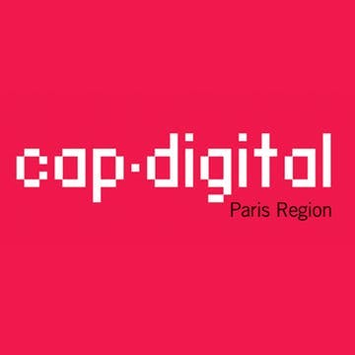

Quinten & Sovereign Technologies
Cap Digital: Quinten est un lauréat de l'appel à projets Hyper Open X, visant à diffuser des technologies cloud/edge développées localement au sein de l'écosystème numérique français, en particulier les PME et les startups. Opéré par Cap Digital et Bpifrance dans le cadre du plan France 2030.
Nous avons également développé une expertise approfondie dans les technologies souveraines et les applications d'IA de qualité réglementaire, impliquant des Modèles de Langage de Grande Taille (LLM).
STRICTLY CONFIDENTIAL
QH: Quinten Health

Slide 40
Quinten & Quinten Finance
Our offer
Examples of projects
Table of Contents

Slide 41

We support our clients in transforming the way they make decisions, through three complementary levels of intervention — depending on their needs for understanding, prediction, or augmented thinking.
Understand —
Diagnose & make sense of complexity
Prévoir —
Anticiper et déclencher les bonnes actions
Amplify —
Support decision-making in real time
Découvrir et structurer des phénomènes commerciaux complexes en utilisant des données disponibles. Clarifier les causes profondes, mesurer les impacts et façonner des stratégies opérationnelles.
Detect weak signals, generate forecasts, and uncover emerging risks or opportunities.
Enable targeted, timely action before issues escalate.
Provide augmented intelligence, connected to real-time data, to support human reasoning.
The system doesn’t just predict — it thinks with you.
Absences du personnel des ressources humaines
Sales performance diagnostics
Churn alerts
Workload forecasting
GenAI powered prospecting tool
Real-time business insights
Marketing efficiency audit
Étude sur la perte de clients
Fraud detection
Commercial recommendations
Assistant intelligent spécifique aux entreprises
• Data-driven diagnostics
• AI roadmap
• Strategic recommendations
• Risk and opportunity scores
• Alerting systems
• Action prioritization
• Custom AI assistant
• Augmented search engine
• Real-time recommendations
Deliverables
Deliverables
Deliverables

Slide 42
Accelerating Business Decisions with Tailored AI and Expertise
Text:
What do we provide?
- Analysis
- Industrialized Product (on premise)
Text:
→ Purpose-built AI tools, designed for speed and impact on high-stakes topics like growth and business risk
→ Augmented consulting, to guide decisions on complex or sensitive issues such as commercial performance and workforce dynamics
Next slide: "Augmented consulting" method to be further developed + equipped advice

